Slide 1

Flipkart Customer Segmentation & Targeted Marketing Intelligence
Preprocessing

Slide 2
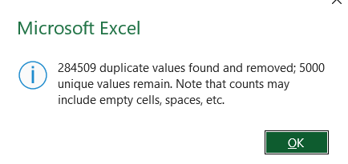

Slide 3
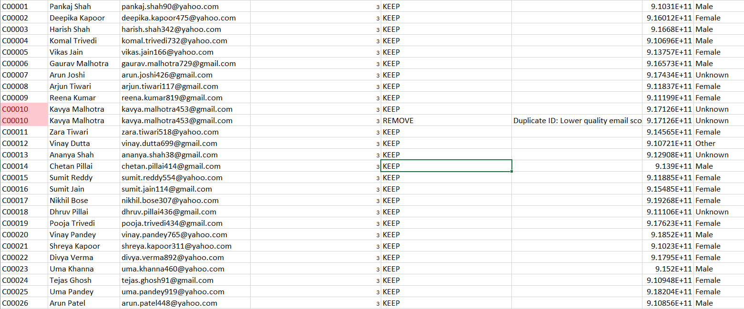

Slide 4


Slide 5


Phase 3.2
Phase 3.3

Slide 6


Phase 3.4
Phase 4.1

Slide 7


Phase 4.2
Phase 4.3

Slide 8


Phase 4.4
Phase 5

Slide 9
Thank you

